Slide 1



Development of a next generation sequencing technique to characterize and identify reassortant HPAI H5N1 clade 2.3.2.1c virus circulating in poultry in Indonesia
Hendra Wibawa
Disease Investigation Center Wates
(Balai Besar Veteriner Wates)
Yogyakarta, Indonesia

Slide 2
Development of next generation sequencing technique to characterize
and identify reassortant highly pathogenic avian influenza H5N1
clade 2.3.2.1c virus circulating in poultry in Indonesia
H. Wibawa^{1*}, H. Mulyawan¹, T. Mahawan², E. A. Srihanto³, Y. Miswati⁴, N. M. Hutagaol⁵,
A. Riyadi⁶, D. H.W. Hartawan⁷, F.Hendrawati⁸, Deswarni⁹, F.C. Zenal¹⁰, N. Hartaningsih¹⁰,
S. Idris¹¹, L.Schoonman¹⁰, J. McGrane¹⁰, B. Poermadjaja¹, Filip Claes¹⁰, F. S. Tjatur Rasa¹¹
*Corresponding Author: hendra.wibawa@pertanian.go.id
¹ Disease Investigation Center Wates, ² Disease Investigation Center Subang,
³ Disease Investigation Center Lampung, ⁴ Disease Investigation Center Bukittinggi,
⁵ Disease Investigation Center Medan, ⁶ Disease Investigation Center Banjarbaru,
⁷ Disease Investigation Center Denpasar, ⁸ Disease Investigation Center Maros,
⁹ Animal Health Laboratory Jakarta Province,
¹⁰ Food and Agriculture Organization of the United Nation (FAO),
Emergency Centre for Transboundary Animal Diseases (ECTAD)
¹¹ Directorate Animal Health, Directorate General of Livestock and Animal Health Services,
Ministry of Agriculture, Jakarta, Indonesia.
Keywords: Influenza, HPAI, Reassortment, Sequencing, NGS

Slide 3
Introduction
Two highly pathogenic avian influenza virus (HPAIV) H5N1 sublineages are remain endemic in Indonesia:
- clade 2.1.3.2 and clade 2.3.2.1c
Although clade 2.3.2.1c virus has been predominantly detected in poultry since 2013, clade 2.1.3.2 is still sporadically found in North Sumatra,
Most of evolutionary studies for Indonesian H5N1 virus are based on the hemagglutinin (HA) gene segment,
Thus, little is known whether co-circulation of these H5N1 clades amongst poultry in Indonesia have caused genetic reassotment,
If so, it is unclear whether this event caused a significant change on the major molecular determinant related to HPAIV pathogenecity.

Slide 4
Aims
This study aims:
to sequence and to characterize HPAIV H5N1 samples collected from recent poultry outbreaks in Indonesia using next generation sequencing (NGS) technique, and
to detect and to identify reassortments between circulating H5N1 virus sublineages or between H5N1 and other virus subtypes in Indonesia.

Slide 5
Materials and Methods

Slide 6
Samples and IVM Network
HPAIV Outbreaks reported by District
IVM Network
17 tissues and 4 oropharyngeal swab samples from a range of bird species (chickens, ducks, quails, wild birds) collected mainly from small-medium comercial and backyard farms HPAIV outbreaks in Java, Sumatra, Sulawesi, and Bali (December 2015 - April 2016).
The samples were sent to Disease Investigation Centers (DICs) for AIV tests using Influenza Virus Monitoring (IVM) procedures developed by the Government of Indonesia and FAO in 2014.
Type A positive samples from each DIC were transferred to the national AIV reference laboratory at DIC Wates for whole-genome sequencing using NGS.
Report to Government for intervention and control
OI by 8 DICs:
Sample Collection and AIV Testing (PCR, VI, HI-PreScreen)
DIC Wates:
Genetic
Antigenic
using NGS and antigenic cartography

Slide 7
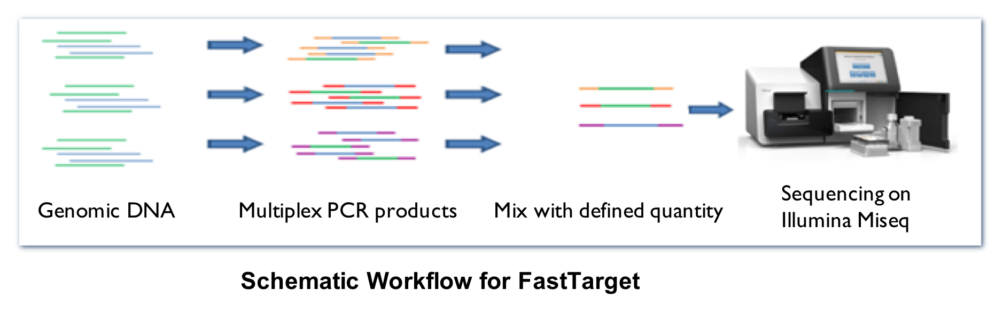
NGS Strategy
Realtime PCR MA
Ct < 27 (clinical sample) or
Ct < 30 (isolat) before NGS
Genomic PCR
Multisegment reverse transcription
and amplification
Purification of
PCR Amplicons
Multisegments RT-PCR (Zhou et al., 2009)
DNA Quantification
using Fluorometer
DNA Library Prep using
Nextera XT (Illumina)
Illumina Miseq

Slide 8
Bioinformatics Anlaysis
Phylogenetic analysis:
A Maximum-likelihood tree was reconstructed in MEGA v7.0.21using the general time reversible (GTR) + G model with 1000 bootstrap reps.
Recombination analysis:
SimPlot and BootScan analyses in SimPlot atau RDP4

Slide 9
Results

Slide 10
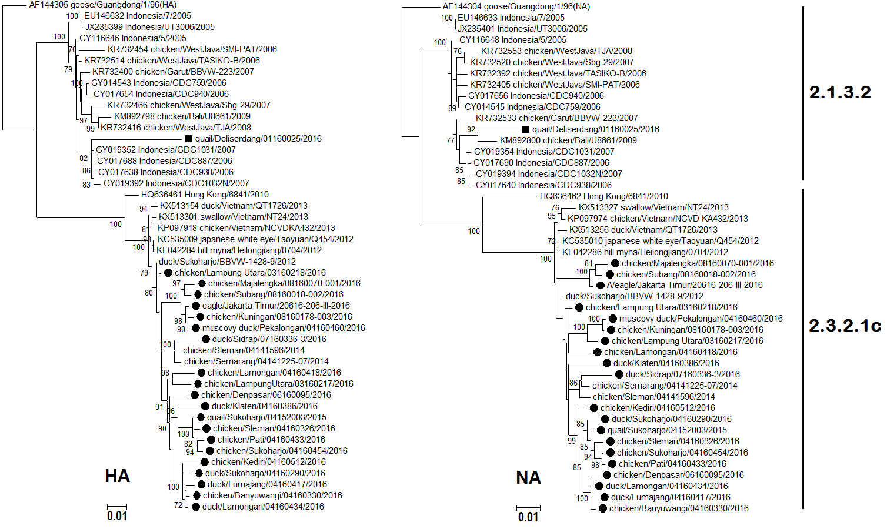
HA and NA phylogenetic analysis

Slide 11
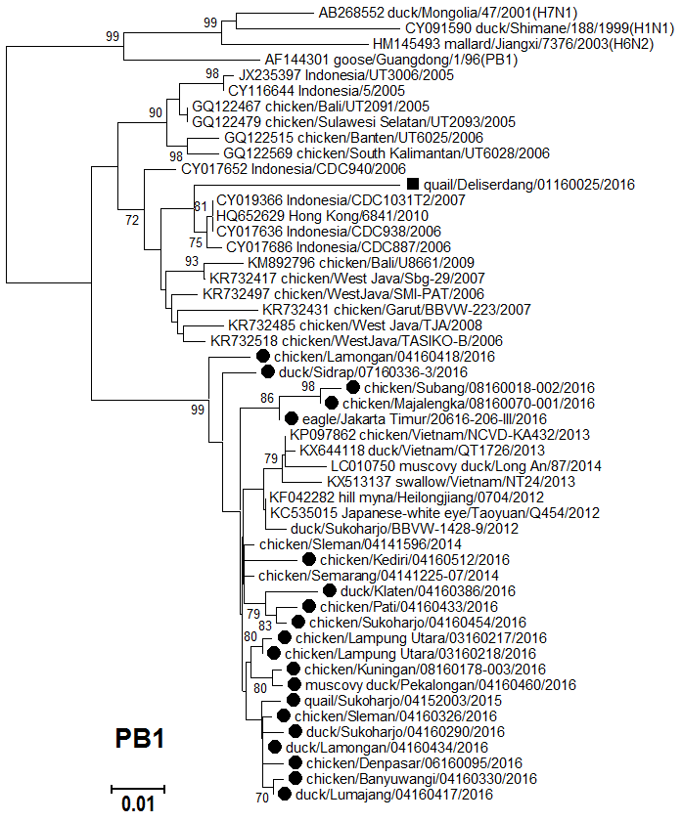
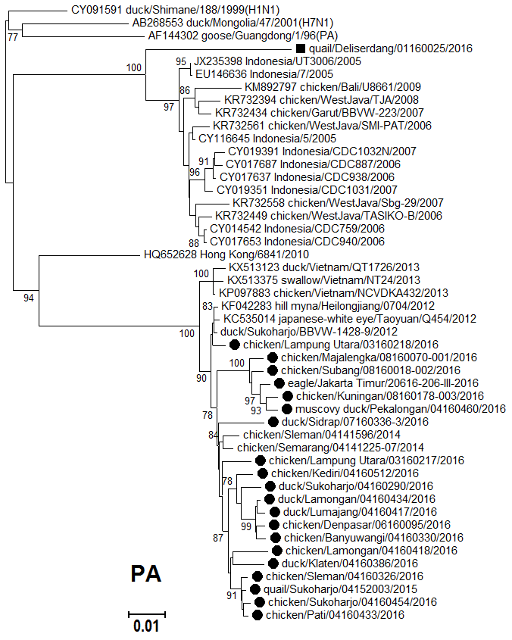
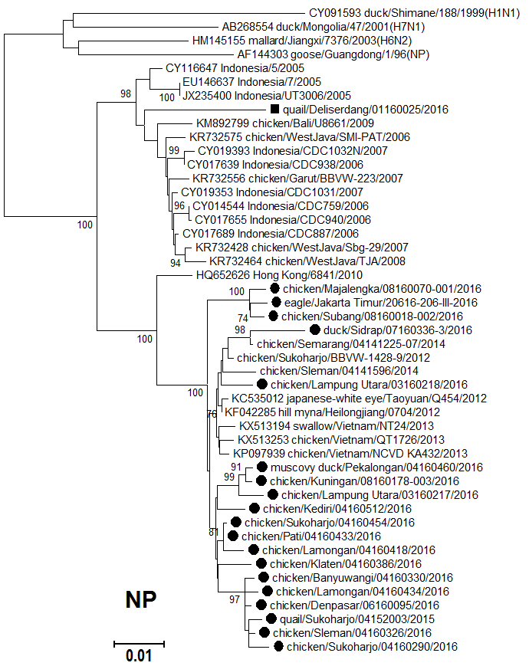
PB1, PA, NP phylogenetic analysis
LPAI Asia
H5N1 2.1.3.2
H5N1 2.3.2.1c
*PB1 length (partial CDS 1040 bp)

Slide 12
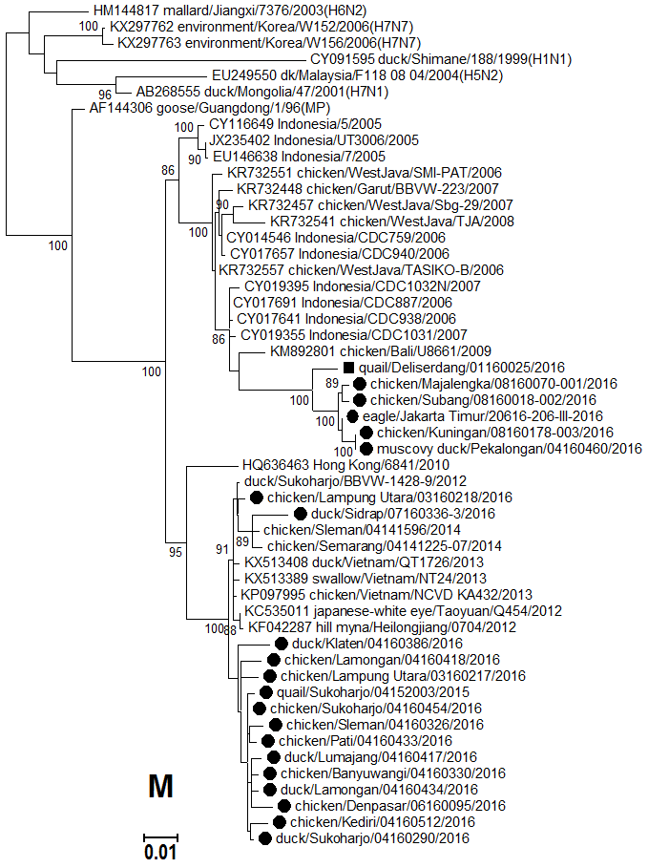
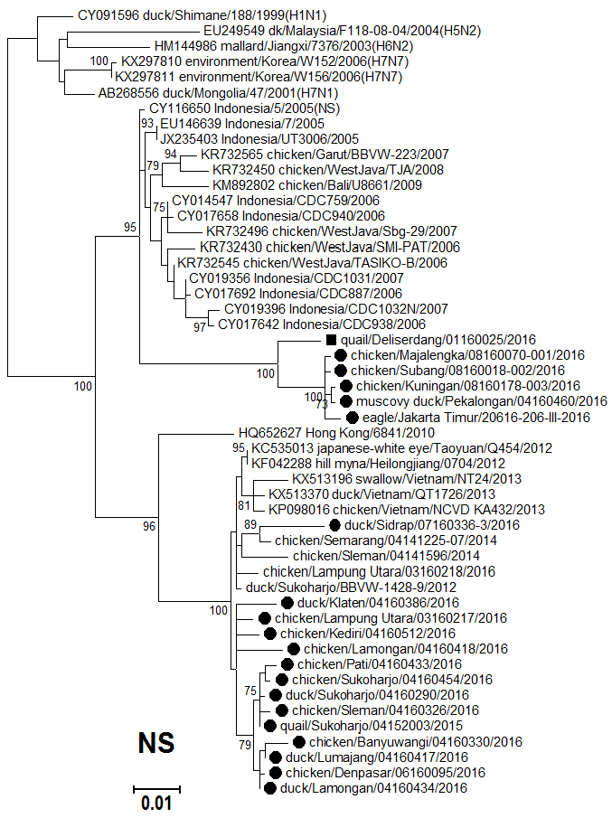
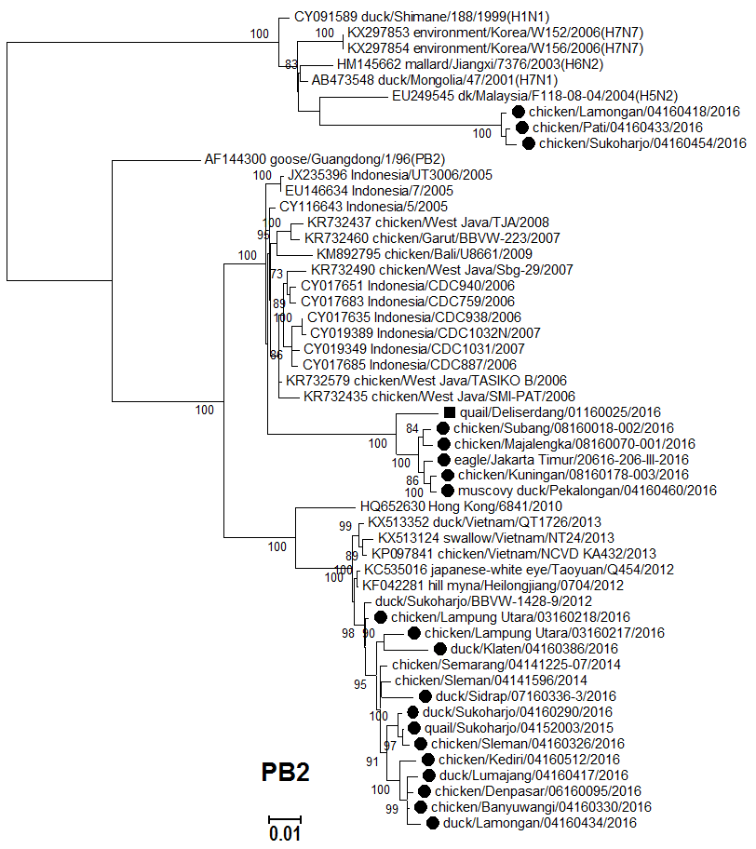
MP, NS, PB2 phylogenetic analysis
LPAI Asia
H5N1 2.1.3.2
H5N1 2.3.2.1c
Potential reassortant Group I
Potential reassortant Group II

Slide 13
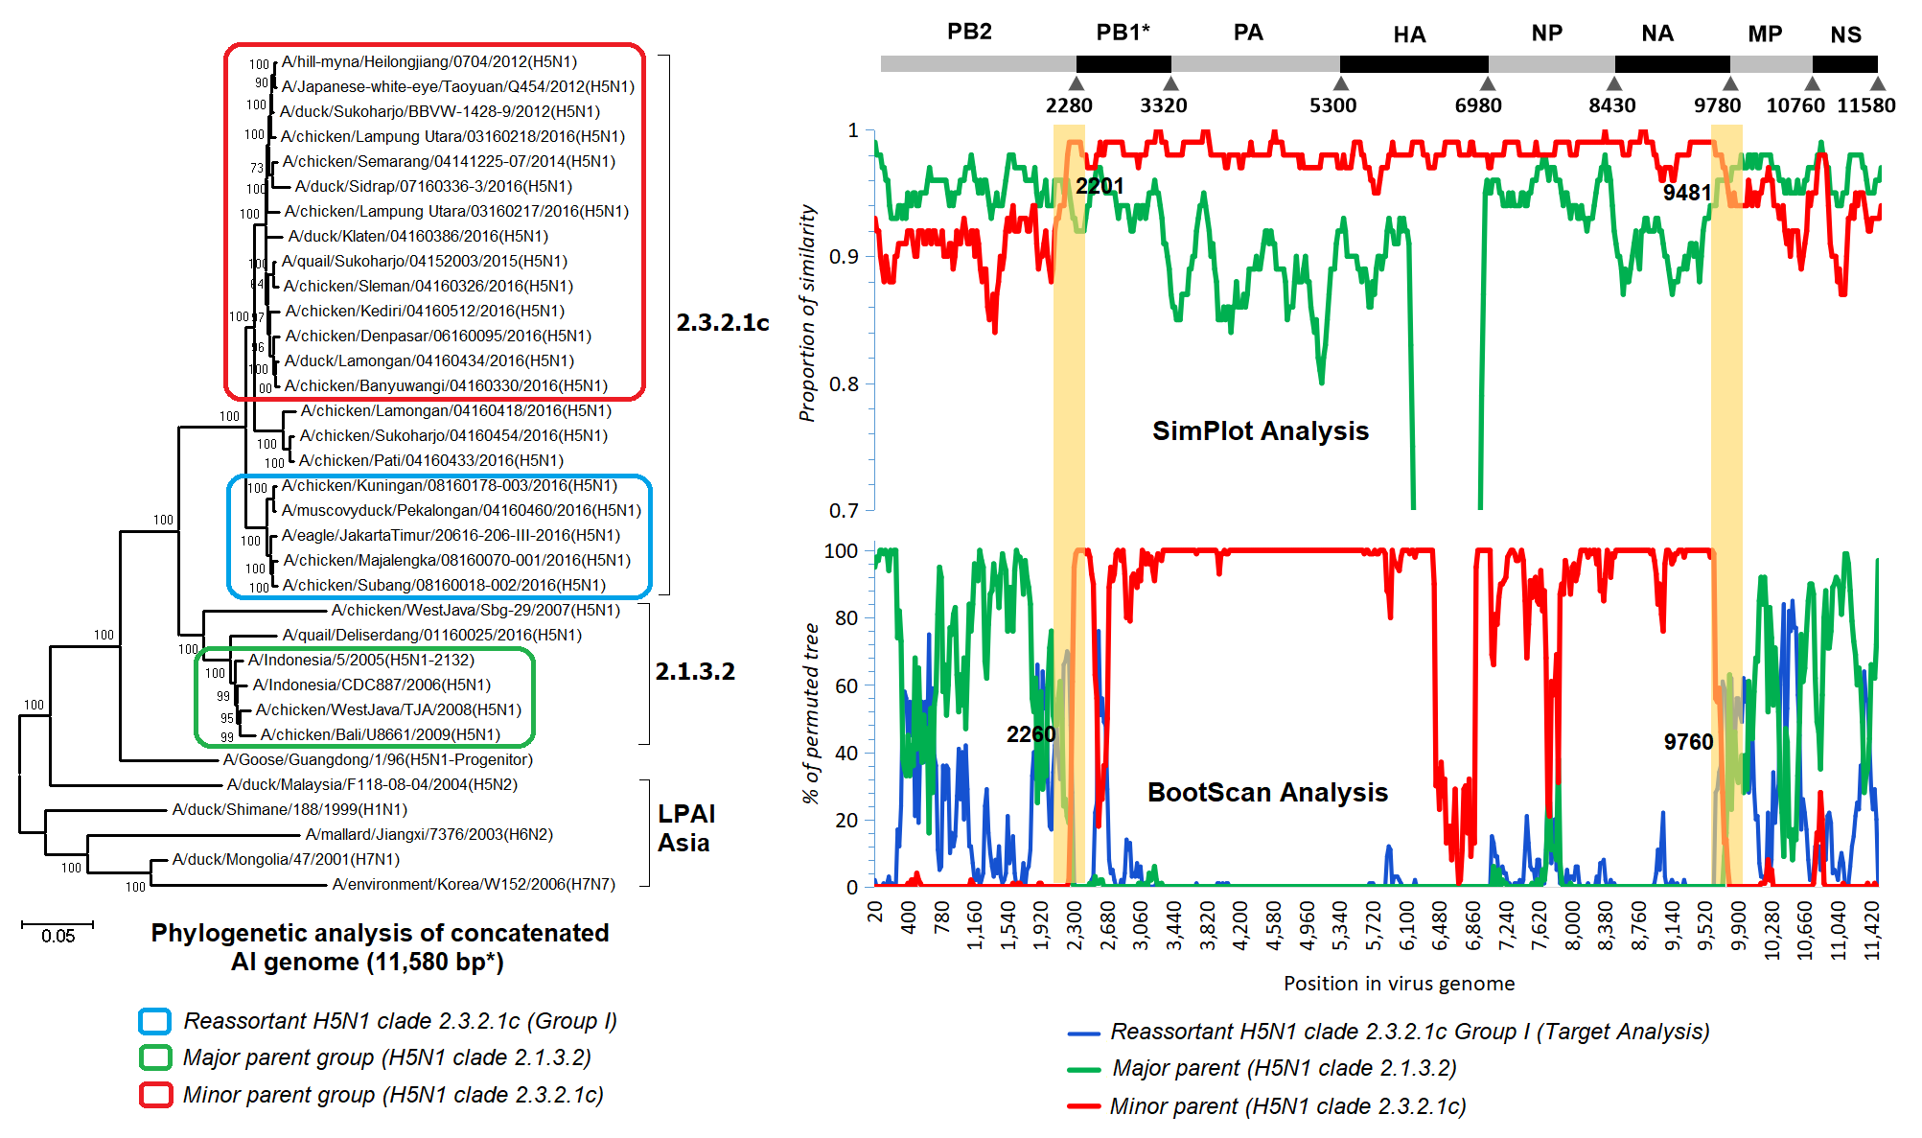
Recombination Analysis
Detection of reassortant H5N1 clade 2.3.2.1c virus (Group I)
*PB1 length (partial CDS 1040 bp)

Slide 14
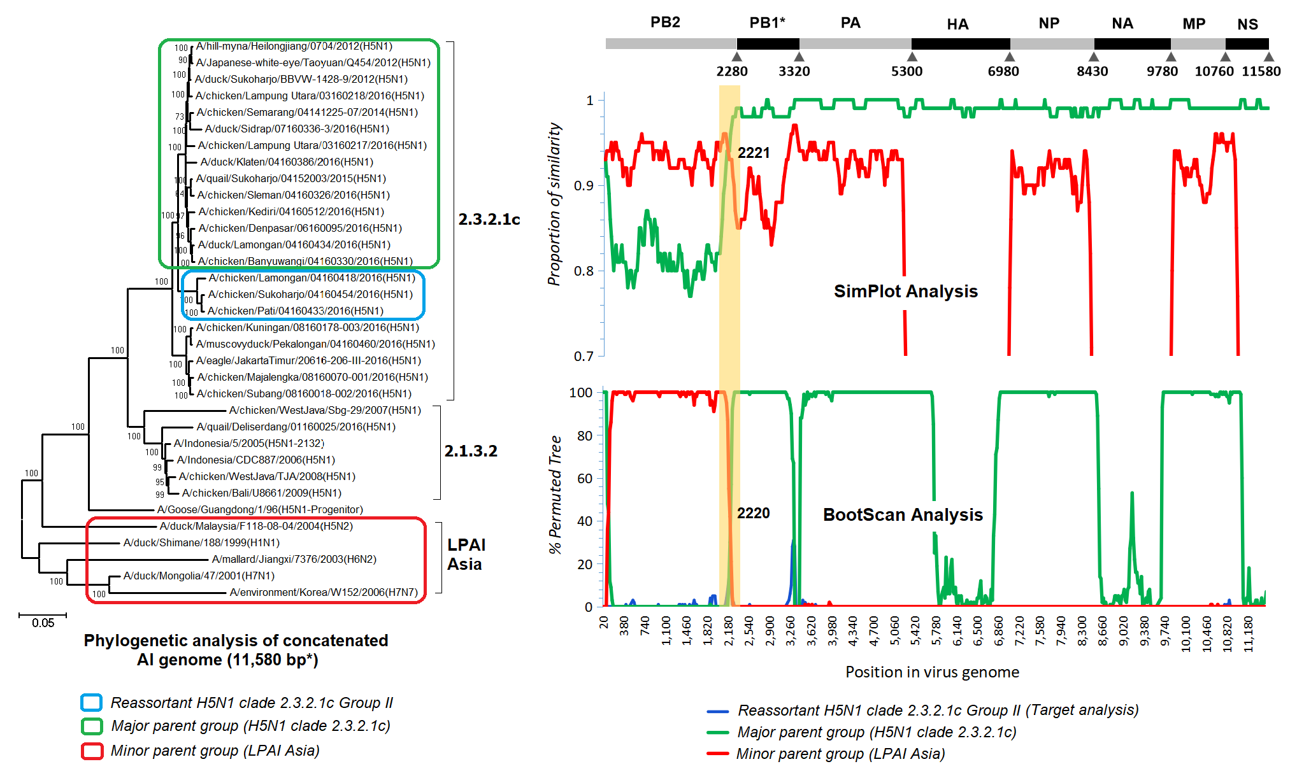
Recombination Analysis
Detection of reassortant H5N1 clade 2.3.2.1c virus (Group II)
*PB1 length (partial CDS 1040 bp)

Slide 15
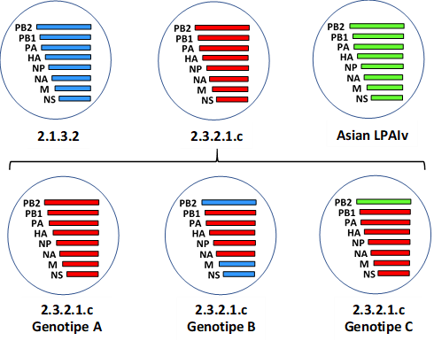
Schematic diagram of H5N1 clade 2.3.2.1c genotyes in Indonesia
No reassortant
Reassortant
Group I
Reassortant
Group II

Slide 16
Molecular Analysis
Reassor tant H5N1 clade 2.3.2.1c | Virus name | Cleavage site | Airborne transmission determinants |  |  |  |  |  |  |  |  |  | PDZ motifs | Antiviral resistance markers
 |  | HA | HA |  |  |  |  | PB2 |  |  |  |  | NS1 | NA | M2
 |  | 323-332 | 103 | 154 | 156 | 182 | 220 |  | 222 | 224 | 315 | 627 | C-terminal | 116, 117, 119, 150, 223, 247, 275, 295 | 27 | 31
No Reassort ment | ck/Lampung/ 03160217/ 2016 (ref) | RERRRKR*G | H | D/ N/S | A | N | N |  | Q | G | T | E | ESEV | V, I, E, K I, S, H, N | I | S
Group I | ea/Jakarta Timur/2016 | RERRRKR*G | H | N | A | N | N |  | Q | G | T | E | ESEV | V, I, E, K I, S, H, N | A | N
 | ck/Majalengka/2016 | RERRRKR*G | H | N | A | N | N |  | Q | G | T | E | ESEV | V, I, E, K I, S, H, N | A | N
 | ck/Kuningan/ 2016 | REKRRKR*G | H | N | A | N | N |  | Q | G | T | E | ESEV | V, I, E, K I, S, H, N | A | N
 | ck/Subang /2016 | RERRRKR*G | H | N | A | N | N |  | Q | G | T | E | ESEV | V, I, E, K I, S, H, N | A | N
 | md/Pekalongan/2016 | REKRRKR*G | H | N | A | N | N |  | Q | G | T | E | ESEV | V, I, E, K I, S, H, N | A | N
Group II | ck/Pati/ 2016 | RERRRKR*G | H | N | A | N | N |  | Q | G | T | E | ESEV | V, I, E, K I, S, H, N | I | S
 | ck/Sukoharjo/ 2016 | RERRRKR*G | H | N | A | N | N |  | Q | G | T | E | ESEV | V, I, E, K I, S, H, N | I | S
 | ck/Lamongan/ 2016 | RERRRKR*G | H | D | A | N | N |  | Q | G | T | E | ESEV | V, I, E, K I, S, H, N | I | S

Slide 17
Conclusion
This study identified an inter-lineage and inter-subtype reassortant HPAIV H5N1 clade 2.3.2.1c virus in Indonesia.
It remains unclear when and where the reassortment event occurred.
The samples were mainly collected from small-medium commercial poultry and backyard farms representing low biosecurity and mixed farming systems which these might have contributed to co-infection of AIVs resulting in reassortant variants.
The results highlight the importance of continued molecular surveillance to monitor influenza virus evolution.

